Slide 1
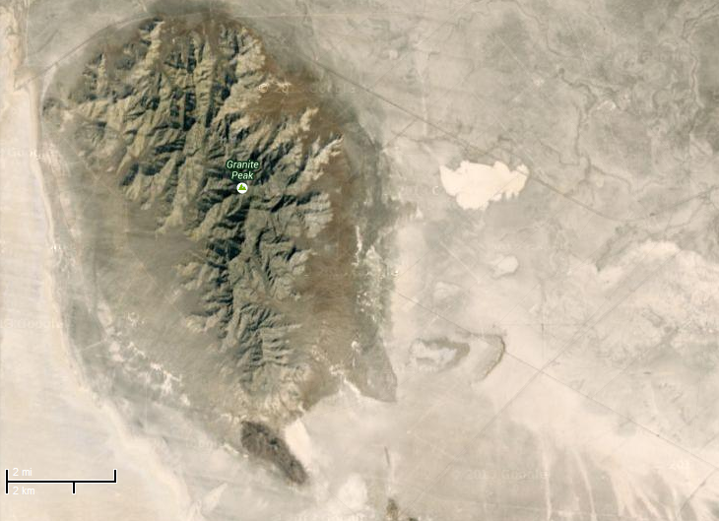



The temperature gradient and transition timescales as a function of topography in complex terrain
Chad Higgins, Kellie Vache, Chadi Sayde, Sebastian Hoch, and Eric Pardyjak

Slide 2
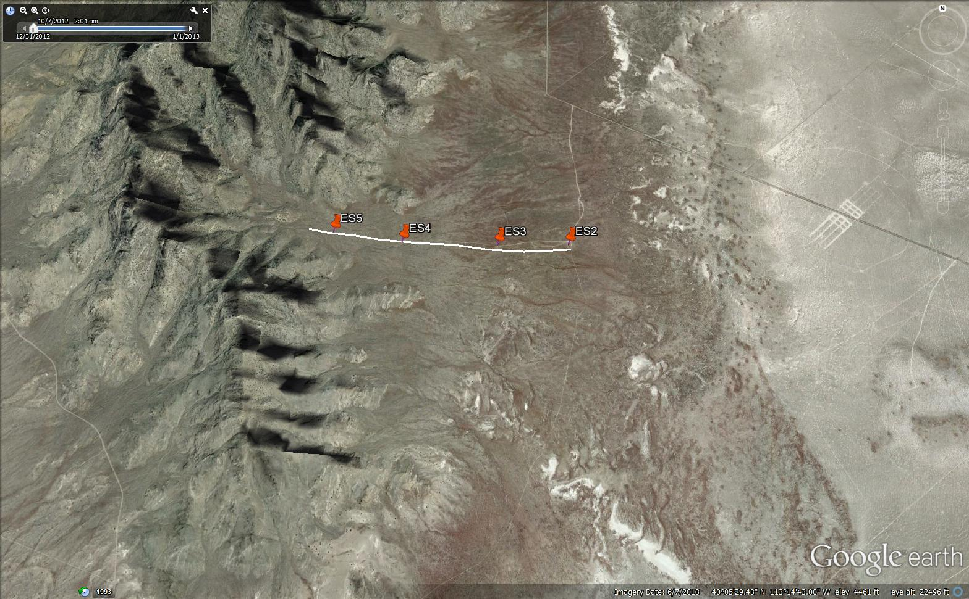
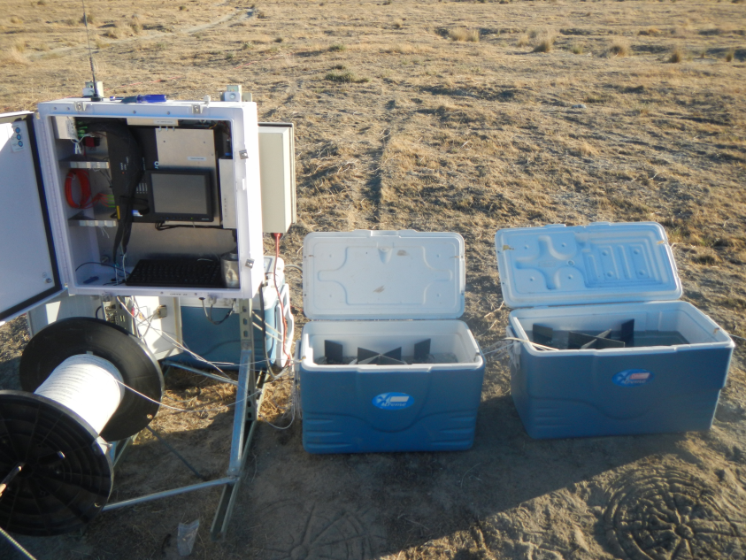

Slide 3
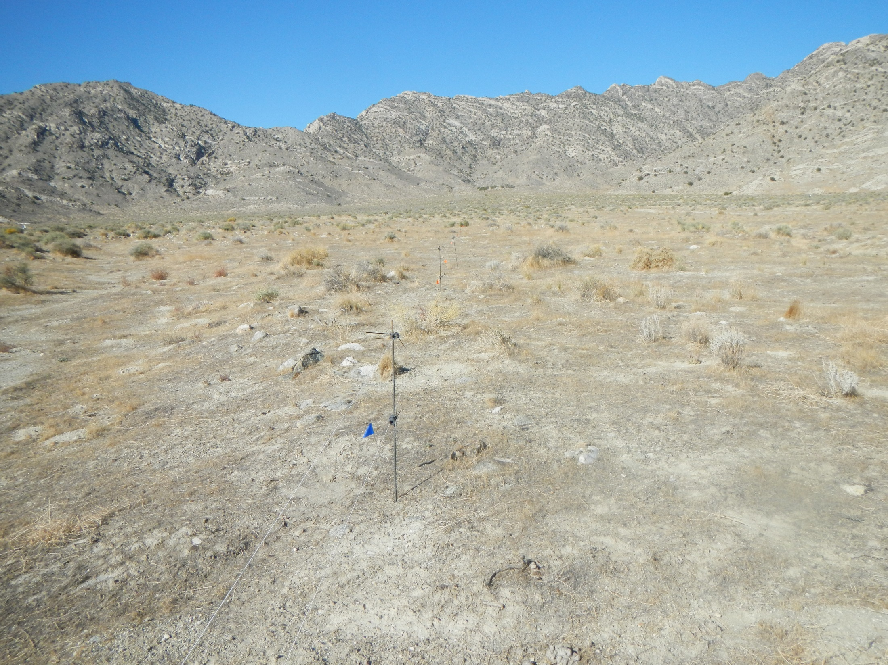
Experiment specifics
1.5mm white multimode fiber optic cable
Oryx DTS unit, 1m, 2 minute resolution
4km sample range
Double ended measurement, 2 calibration baths
~100m total elevation gain
Wild horses dragged the experiment away, twice!
Thank you
CTEMPS.org
1m
0.5m
Channel 2
15s later
Channel 1

Slide 4
Calibrated data, distance time slice at one height
Oct 9 2012, z=0.5m
Notes:
Clear shadow fromt, transition top to bottom in evening, bottom to top in morning, there are some residual warm upward motions after the passing of the shadow front, you can see the formation of a cold pool, horizontal streaks investigated later, there is an apparent strong advection that can be seen in the dTdt of each range location, this advection is in the proper sign for energy balance closure, both day and night.

Slide 5
Notes:
say both stable in the slope normal direction, but also stable in elevation, how does this effect the actual flow?

Slide 6


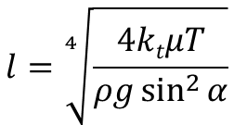

Prandtl 1942 theory
$$−ΔT$$
$$l=\sqrt[4]{\frac{4ktμT}{ρg\sin^{2}{α}}}$$
T $=C\exp{\frac{n}{l}}\cos{\frac{n}{l}}$
$$\frac{∂T}{∂z}\sim {(sin{α})}^{1/2}$$

Slide 7
day
night

Slide 8
Search for explanatory variables
Slope
Elevation
Relative positioning?
Contributing area?
DEM not sufficient, but we can look at Google earth Photos and on-the-ground photos

Slide 9
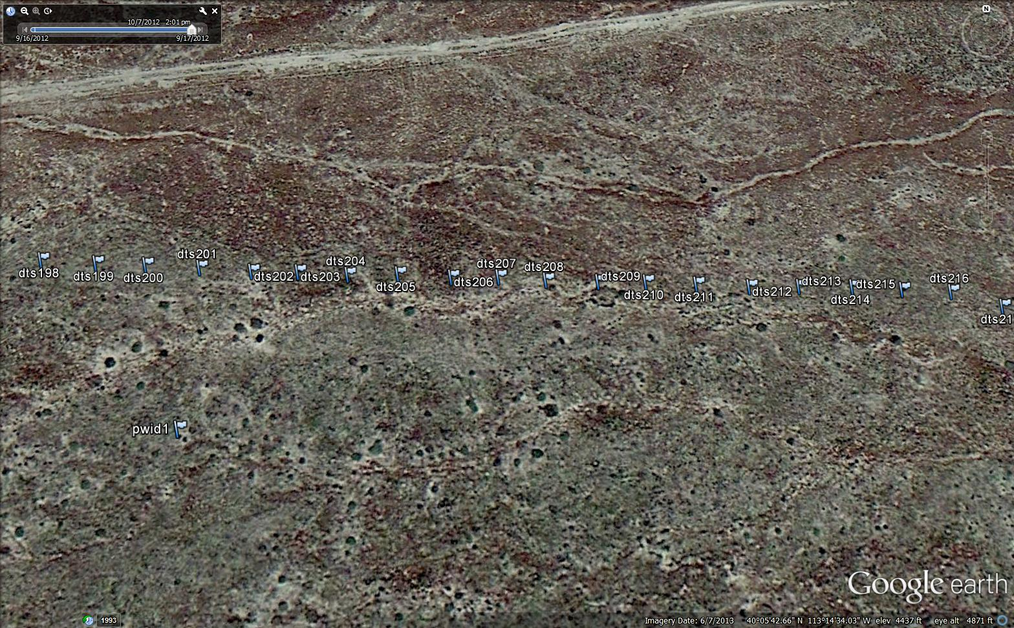
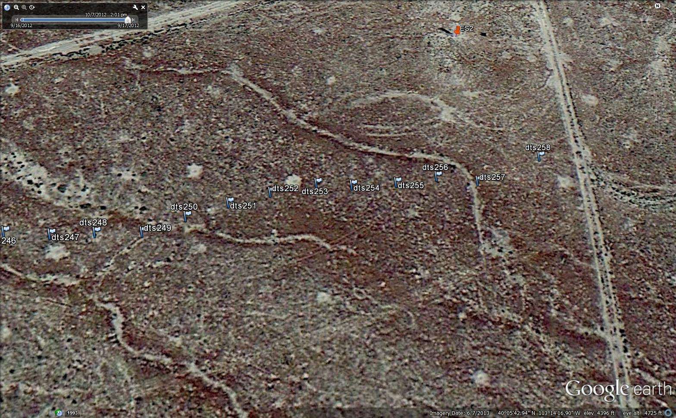
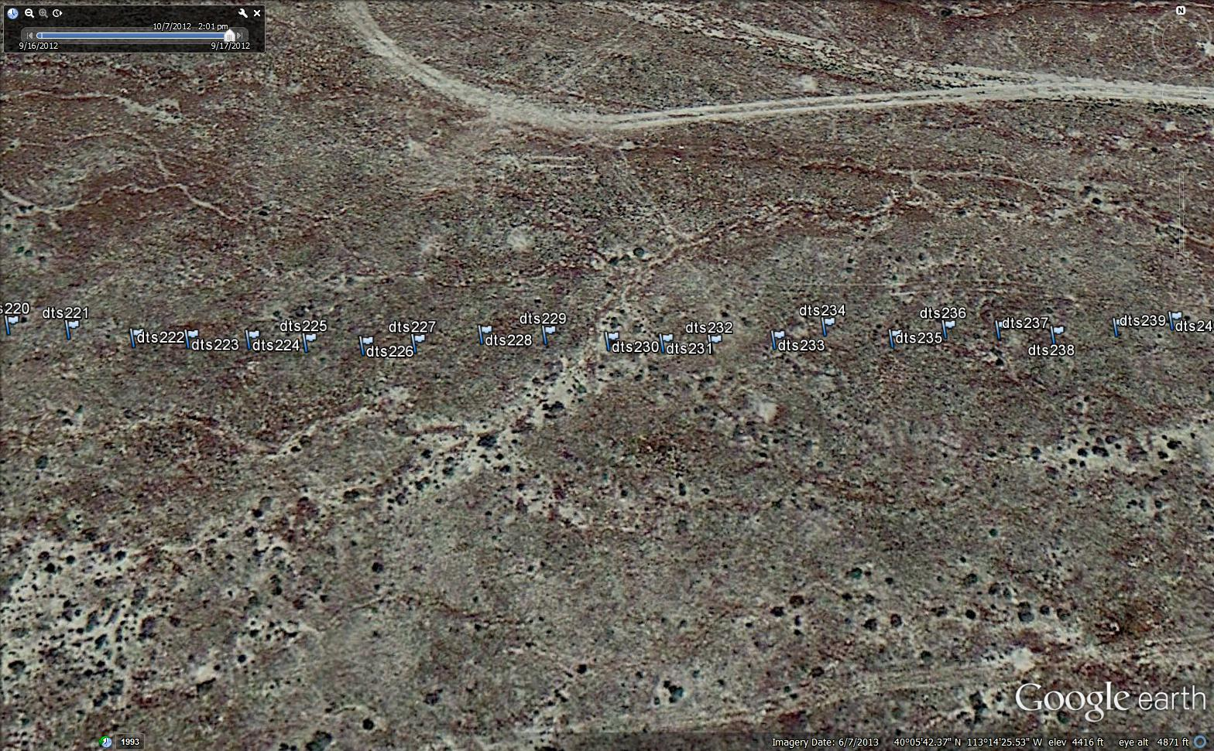

Slide 10
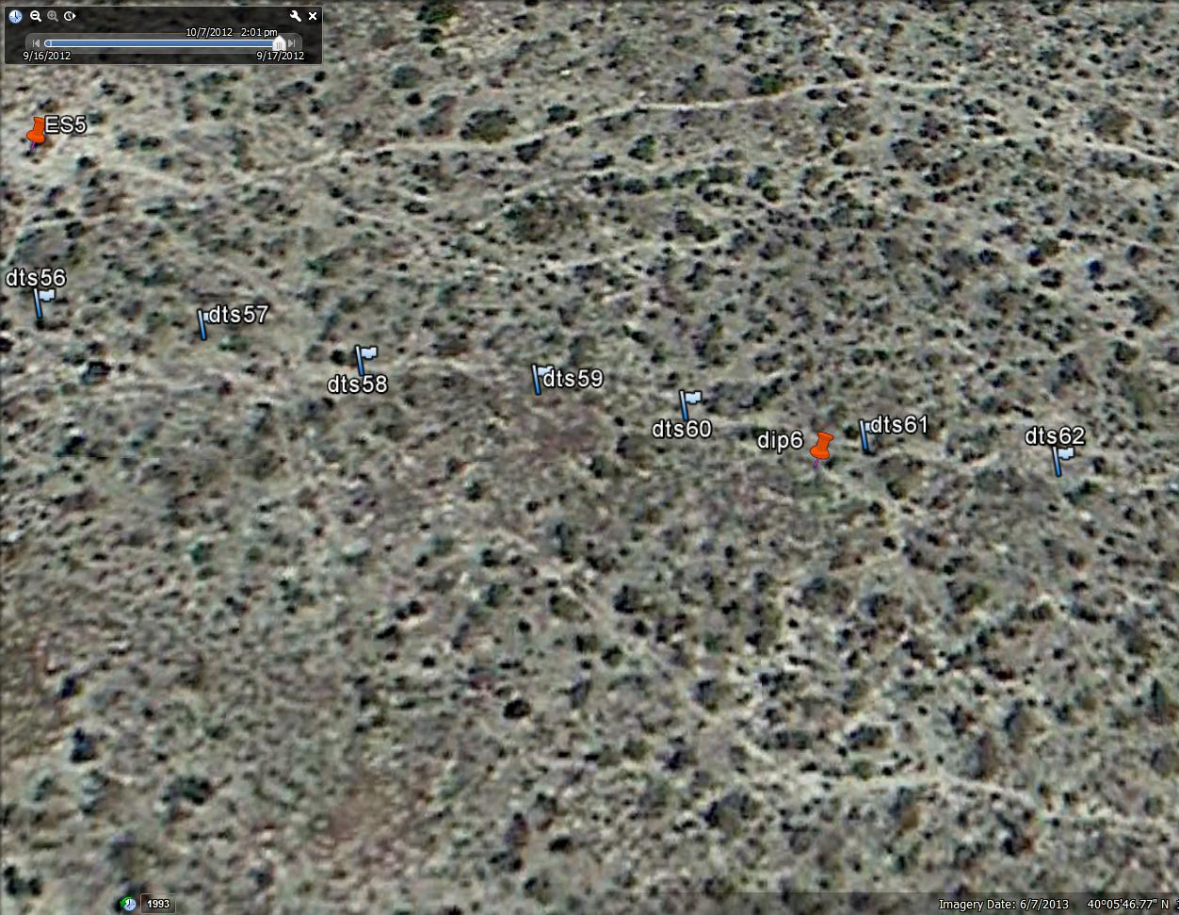
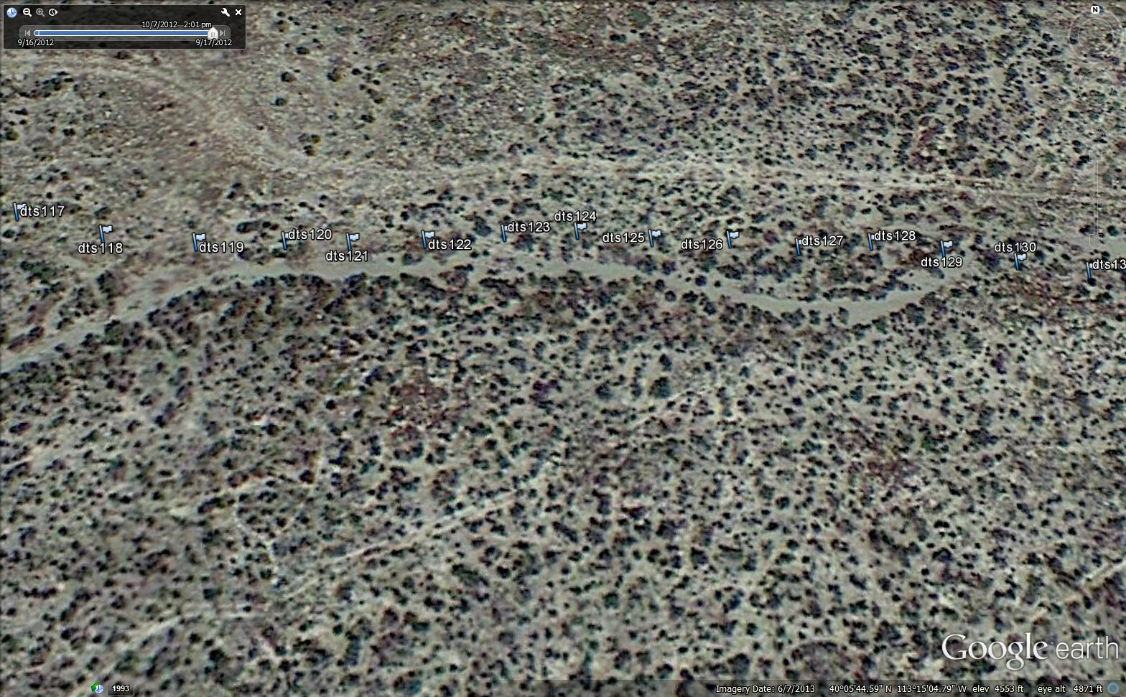
Micro-topography has a dramatic influence on drainage flows, all of these features are not visible on a 10m DEM

Slide 11
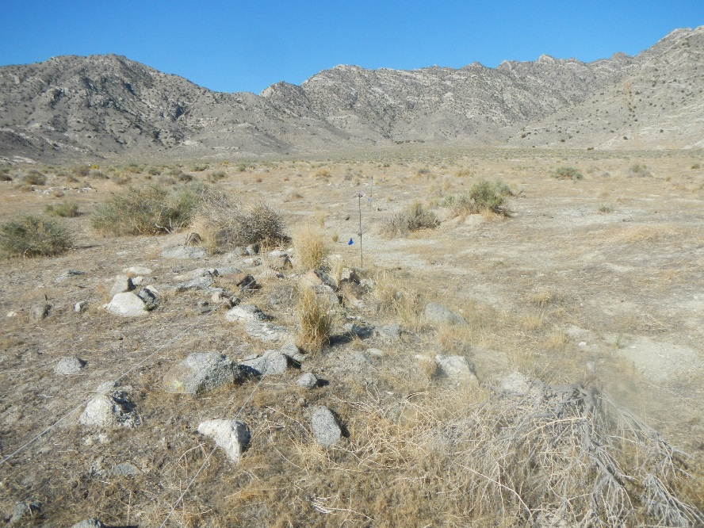
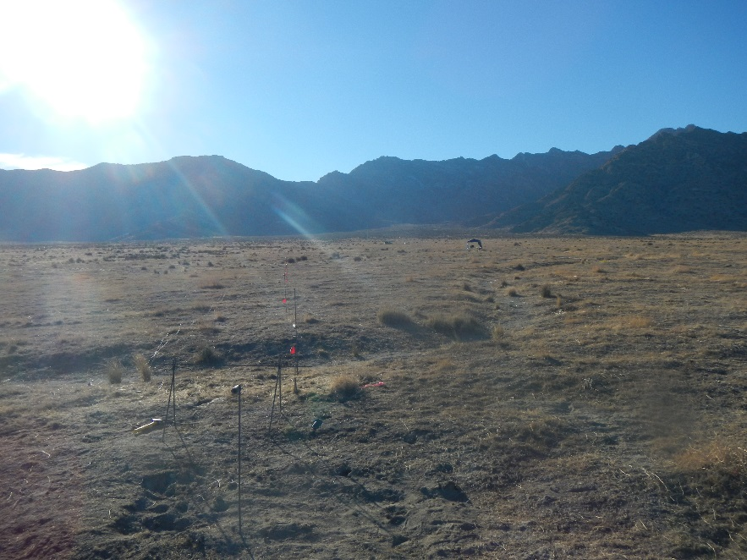

Slide 12
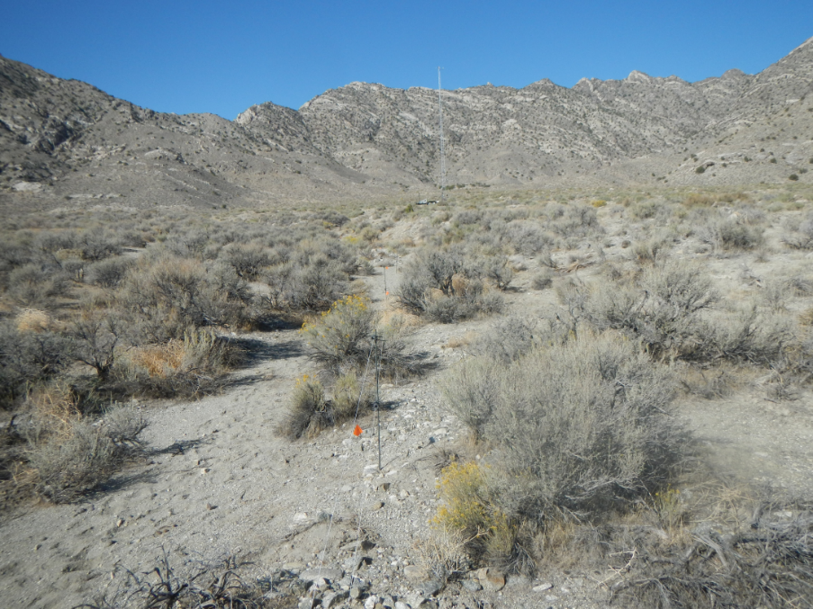
Contributing area, and thus the relative spatial positioning is a major factor in these flows
ES3

Slide 13
Search for explanatory variables
Slope
Elevation
Relative positioning?
Contributing area?
Hypothesis stage at this point, can verify if u* is a function of range during the day, need higher resolution DEM to compute drainage areas at night

Slide 14

R_{n}
H
$$ρcp\frac{∂T}{∂t}$$
A
G

Slide 15

Assume a functional form
$$T\left(t\right)=Ae^{−λt}−Bt+c$$
Use shadow front as starting time
Fit with nonlinear least squares

Slide 16
Fast timescale
Cooling rate

Slide 17
Oct 9 2012, z=0.5m
Clear sky conditions

Slide 18
Oct 14 2012, z=0.5m
Clear sky conditions

Slide 19
Clouds, but apparent shadow front
Oct 15 2012, z=0.5m

Slide 20
Clouds, but apparent shadow front
Oct 14 2012, z=0.5m

Slide 21
Clouds, but no apparent shadow front
Oct 11 2012, z=0.5m

Slide 22
Clouds, but no apparent shadow front
Hypothesis: energy balance closure is better on this day.
Oct 13 2012, z=0.5m

Slide 23
Conclusions
Micro-topography has high impact on nighttime temperature and air drainage and temperature gradient
Slope has a greater impact on daytime temperature gradients, but spatial disposition plays a equally important role
The daytime temperature gradient begins to vanish ad we go farther up the hill
The onset timescale of the temperature transition is impacted heavily by local slope
The cooling rate is more impacted by the spatial positioning
Advection always has the proper sign in complex topography for the thermal driven flows
If there is no observable shadow front, the evening transition occurs in the opposite direction

